Slide 1

Warmest Regards
from
Golam Md. Muradul Bashir
Professor & Chairman
Dept. of Computer & Communication Engineering
Institute of Information and Communication Technology (IICT)
Bangladesh University of Engineering and Technology (BUET)
Dhaka 1000, Bangladesh
Patuakhali Science and Technology University

Slide 2
Optical Fiber
Communications
— Chapter 1 —
— Introduction —

Slide 3

Introduction
Communication may be broadly defined as the transfer of information from one point to another.
When the information is to be conveyed over any distance a communication system is usually required.
Information transfer is frequently achieved by superimposing or modulating the information onto an electromagnetic wave which acts as a carrier for the information signal
Sophisticated techniques have been developed for this process

Slide 4
Historical development
As early as 1880 Alexander Graham Bell reported the transmission of speech using a light beam
Although some investigation of optical communication continued in the early part of the twentieth century its use was limited to mobile
This was due to both
  the lack of suitable light sources and
  Severely affected by disturbances such as rain, snow, fog, dust and atmospheric turbulence (disorder).

Slide 5

Historical development
A renewed interest in optical communication was stimulated in the early 1960s with the invention of the laser
This device provided a powerful coherent light source, together with the possibility of modulation at high frequency
The use of the laser for free space optical communication proved somewhat limited

Slide 6
Historical development
The proposals for optical communication via dielectric waveguides or optical fibers fabricated from glass to avoid degradation of the optical signal by the atmosphere were made almost simultaneously in 1966 by Kao and Hockham

Slide 7
The general system
An optical fiber communication system is similar in basic concept to any type of communication system.
In electrical communications the information source provides an electrical signal, usually derived from a message signal which is not electrical (e.g. sound), to a transmitter comprising electrical and electronic components which converts the signal into a suitable form for propagation over the transmission medium.

Slide 8
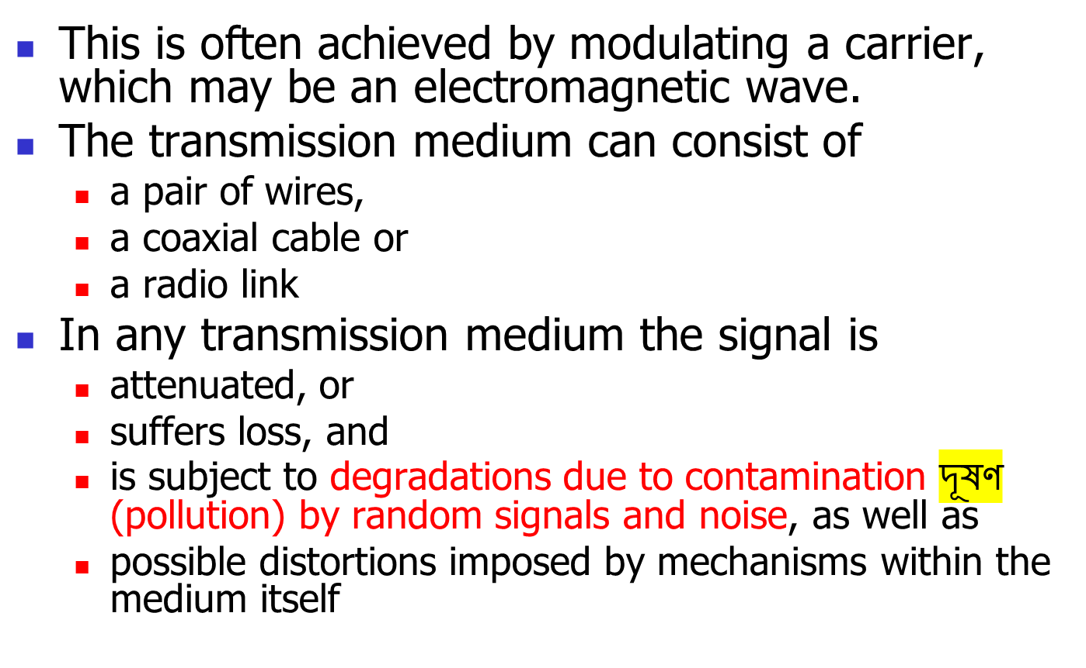




The general system
সিগন্যাল যখন দীর্ঘ পথ অতিক্রম করে, তখন দূরত্বের সাথে সাথে এর ক্ষমতা বা শক্তি কমতে থাকে।

Slide 9




The general system
in any communication system there is a maximum permitted distance between the transmitter and the receiver beyond which the system effectively ceases (ends) to give intelligible communication
For long haul(takes a long time) applications these factors necessitate
  the installation of repeaters or
  line amplifiers at intervals,
both to remove signal distortion and to increase signal level before transmission is continued down the link

Slide 10
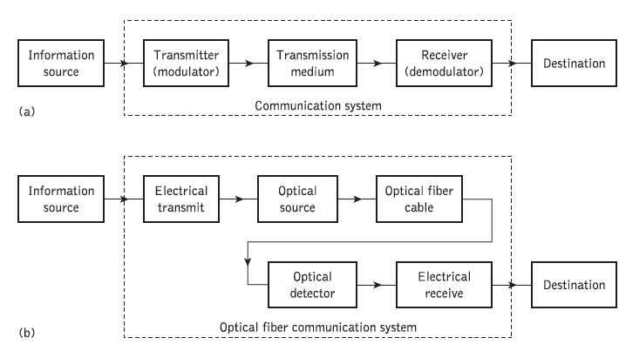
General communication system & optical fiber communication system

Slide 11
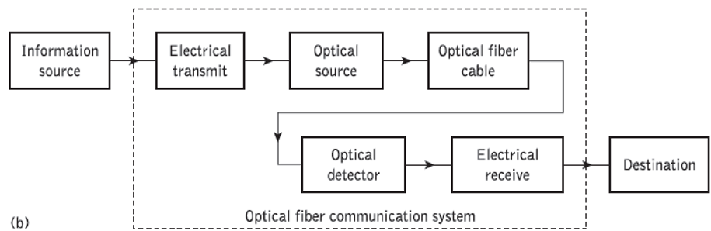




Electrical Communications
Information source provides an electrical signal to a transmitter comprising an electrical stage which drives an optical source to give modulation of the light wave carrier.
The optical source which provides the electrical–optical conversion may be
  either a semiconductor laser or
  light-emitting diode (LED)
The transmission medium consists of an optical fiber cable and
the receiver consists of an optical detector which drives a further electrical stage and hence provides demodulation of the optical carrier. Photodiodes
Data Mining: Concepts and Techniques

Slide 12



The optical fiber communications
The optical carrier may be modulated using either
  an analog or digital information signal.
In analog modulation involves the variation of the light emitted from the optical source in a continuous manner
With digital modulation, however, discrete changes in the light intensity are obtained (i.e. on–off pulses)
Although often simpler to implement, analog modulation with an optical fiber communication system is less efficient, requiring a far higher signal-to-noise ratio at the receiver than digital modulation.
Data Mining: Concepts and Techniques

Slide 13
The optical fiber communications
For these reasons, analog optical fiber communication links are generally limited to shorter distances and lower bandwidth operation than digital links
Data Mining: Concepts and Techniques

Slide 14


A digital optical fiber link using a semiconductor laser source and an avalanche photodiode (APD) detector
Initially, the input digital signal from the information source is suitably encoded for optical transmission.
The laser drive circuit directly modulates the intensity of the semiconductor laser with the encoded digital signal.
Hence a digital optical signal is launched into the optical fiber cable.
The avalanche photodiode (APD) detector is followed by a front-end amplifier and equalizer or filter to provide
  gain as well as linear signal processing and
  noise bandwidth reduction
Finally, the signal obtained is decoded to give the original digital information
Data Mining: Concepts and Techniques

Slide 15
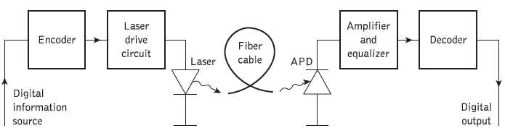
Data Mining: Concepts and Techniques

Slide 16
Advantages of optical fiber communication
Enormous potential bandwidth
  The optical carrier frequency in the range 10¹³ to 10¹⁶ Hz
  Coaxial cable bandwidth typically around 20 MHz over distances up to a maximum of 10 km
Small size and weight
  Optical fibers have very small diameters which are often no greater than the diameter of a human hair
  Even when such fibers are covered with protective coatings they are far smaller and much lighter than corresponding copper cables.
  This is a tremendous advantage towards the improvement of channel congestion in cities
Data Mining: Concepts and Techniques

Slide 17
Advantages of optical fiber communication
Electrical isolation
  Optical fibers which are fabricated from glass, or sometimes a plastic polymer, are electrical insulators and therefore, unlike their metallic counterparts, they do not exhibit earth loop and interface problems.
  This property makes optical fiber transmission ideally suited for communication in electrically hazardous environments
Immunity to interference and crosstalk
  Optical fibers free from electromagnetic interference (EMI), radio-frequency interference (RFI), or switching transients giving electromagnetic pulses (EMPs)
  Hence the operation of an optical fiber communication system is unaffected by transmission through an electrically noisy environment
Data Mining: Concepts and Techniques

Slide 18
Advantages of optical fiber communication
Signal security.
  The light from optical fibers does not radiate significantly and therefore they provide a high degree of signal security
  Unlike the situation with copper cables, a transmitted optical signal cannot be obtained from a fiber in a noninvasive manner (i.e. without drawing optical power from the fiber).
  This feature is obviously attractive for military, banking and general data transmission (i.e. computer network) applications.
Low transmission loss.
  The development of optical fibers over the last 20 years has resulted in the production of optical fiber cables which exhibit very low attenuation or transmission loss in comparison with the best copper conductors.
Data Mining: Concepts and Techniques

Slide 19
Advantages of optical fiber communication
Ruggedness and flexibility.
  Although protective coatings are essential, optical fibers may be manufactured with very high tensile প্রসারণসাধ্য strengths
  Cable structures have been developed which have proved flexible, compact
System reliability and ease of maintenance.
  With fewer optical repeaters or amplifiers, system reliability is generally enhanced in comparison with conventional electrical conductor systems
Potential low cost.
  The glass which generally provides the optical fiber transmission medium is made from sand – not a scarce
  দুর্লভ resource.
  So, in comparison with copper conductors, optical fibers offer the potential for low-cost line communication
Data Mining: Concepts and Techniques

Slide 20
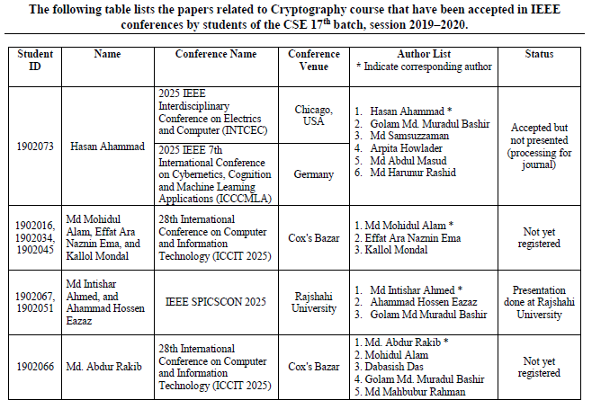

Data Mining: Concepts and Techniques

